Slide 1
UI Dashboard
Normalization Service
(- Rule Engine: deterministic transforms (units, labels)
- LLM Enrichment: AWS Bedrock / Gemini AI for RCA & recommendations
-Pluggable Adapters per DB engine –
Collect raw telemetry via: • Hooks (preferred) • System views (polling fallback)
• Logs / Provider metrics - Convert raw data → JSON Event Contract
Telemetry Bus / Collector
DB Observability Framework
(Collection Layer)
DB Engine
SQL Server
Oracle DB
Azure Cosmos DB
AWS DynamoDB
Snowflake
….
….
….

Slide 2
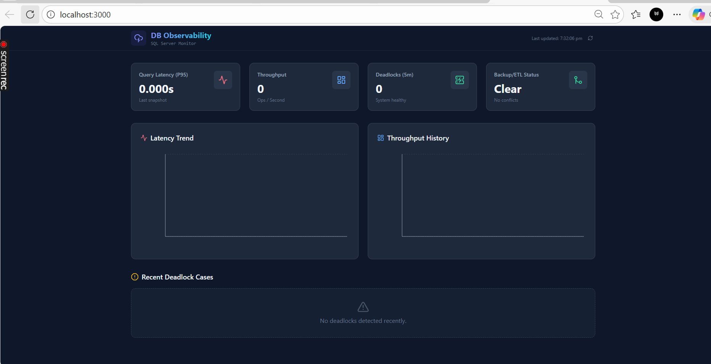
Using Goole AI studio – I prepared this sample code flow

Slide 3
Common query for each data base
/* ============================================================
Deadlock and Observability SELECT Script
Purpose: Query key observability tables/views with comments
============================================================ */
-- 1. Fetch recent deadlock cases with victim details
SELECT TOP 50 CaseId, EventTime, VictimProcessId, VictimLogin, VictimApp, VictimHost,
ResourceType, LockMode, CreatedAt
FROM dbo.DeadlockCases
ORDER BY EventTime DESC;
-- Comment: Quickly review recent deadlock victims and lock types.
-- 2. Fetch rollback cases with reasons
SELECT TOP 50 RollbackId, EventTime, SessionId, Reason, CreatedAt
FROM dbo.RollbackCases
ORDER BY EventTime DESC;
-- Comment: Identify sessions that were rolled back and the reasons.
-- 3. Query normalized metrics for trend analysis
SELECT MetricName, AVG(MetricValue) AS avg_value, MIN(MetricValue) AS min_value,
MAX(MetricValue) AS max_value, COUNT(*) AS sample_count
FROM dbo.NormalizedMetrics
WHERE EventTime >= DATEADD(HOUR, -1, SYSUTCDATETIME()) -- last 1 hour
GROUP BY MetricName;
-- Comment: Aggregate metrics for the past hour to detect anomalies.
-- 4. Join RCA summaries with deadlock cases
SELECT d.CaseId, d.EventTime, d.VictimLogin, d.VictimApp, r.Summary, r.GeneratedAt
FROM dbo.DeadlockCases d
JOIN dbo.DeadlockCasesRca r ON d.CaseId = r.CaseId
ORDER BY d.EventTime DESC;
-- Comment: Show RCA summaries alongside deadlock metadata.
-- 5. Use v_TopLatency view to check top 20 latency queries
SELECT *
FROM dbo.v_TopLatency;
-- Comment: Snapshot of longest-running queries with SQL text preview.
-- 6. Use v_BackupEtlOverlap view to detect overlap
SELECT *
FROM dbo.v_BackupEtlOverlap;
-- Comment: Returns a flag (1) if backup and ETL jobs overlapped.

Slide 4
Flow
SQL Queries (Deadlocks, Logs, Trends)
↓
Normalization (JSON/CSV, aggregates)
↓
Prompt Builder (role + tasks + data)
↓
AWS Bedrock LLM (Claude, Titan, etc.)
↓
LLM Output (Summary, RCA, Recommendations)
↓
Dashboard / Audit Log / Alerts

Slide 5
Example
Analyze the following telemetry data from SQL Server:
Deadlocks:
- 2025-12-14 10:05:00 | Session 42 | UPDATE Orders
- 2025-12-14 11:15:00 | Session 87 | INSERT Customers
Trends:
- Average deadlocks per hour: 2.3
- Peak hour: 11 AM
Logs:- Error 1205 repeated 5 times in last 24 hours
Tasks:
1. Summarize the situation in plain English.
2. Recommend 2 optimizations to reduce deadlocks.
3. Highlight any unusual patterns.
LLM will then generate a clear, human-readable RCA (Root Cause Analysis) style answer.

Slide 6
Feed into Bedrock LLM: Prompt the LLM with context
You are an observability assistant.
Given the following database telemetry, summarize key issues and trends,
and recommend possible optimizations.
Data: {JSON payload here} - (log data which we collected in JSON)
LLM Response The model will produce:
A summary: “Deadlocks peaked at 11 AM, mostly on Orders table updates.”
Recommendations: “Consider indexing Orders.customer_id or reviewing transaction isolation levels.”
Trends: “Deadlocks are increasing compared to yesterday.”

